Slide 1
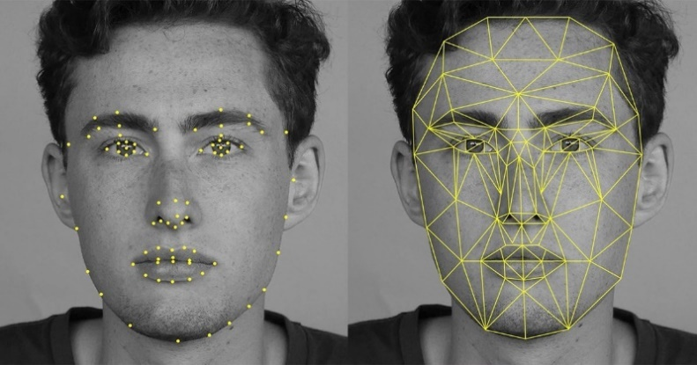
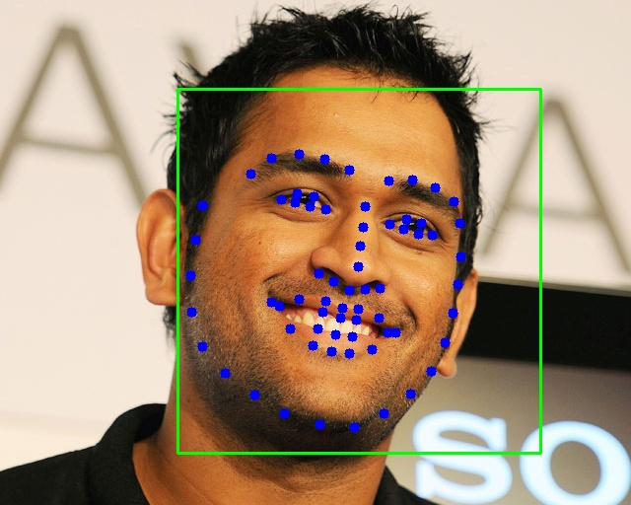
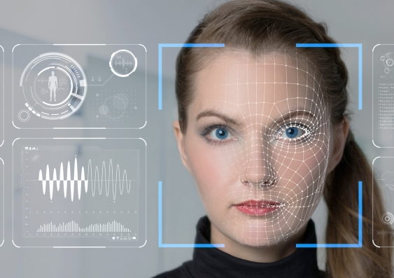
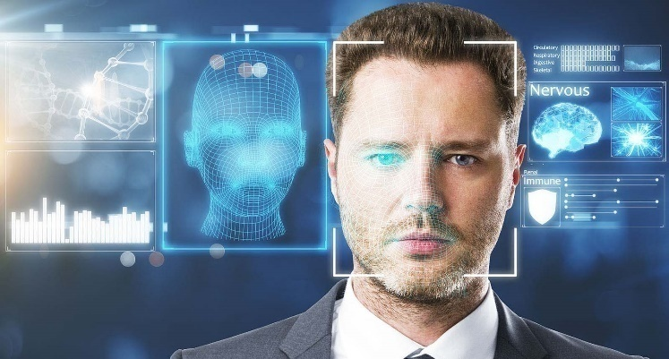
Face Recognition
MS. DHONI

Slide 2
How human can identify face ?
How we are seeing
How we identifying persons
What pattern we are following

Slide 3

How computer see person ?

Slide 4
Image
An image is a picture that has been created by combination of vectors or values.
An image can be described in terms of vector graphics or raster graphics.
An image stored in raster form is sometimes called a bitmap.

Slide 5
Color Space
Color image is combination of three channel
Red Channel
Green Channel
Blue Channel

Slide 6
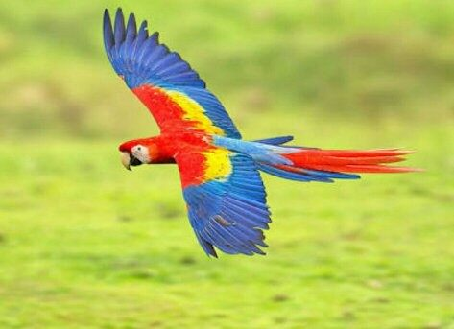
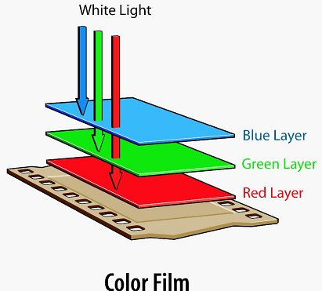
Basics of Image Processing
(343, 473 , 3)

Slide 7
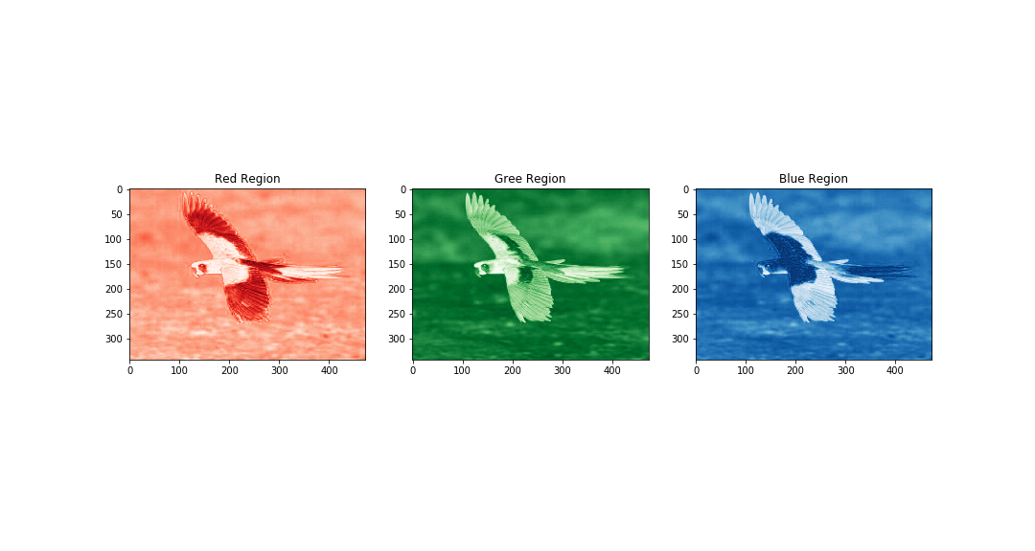
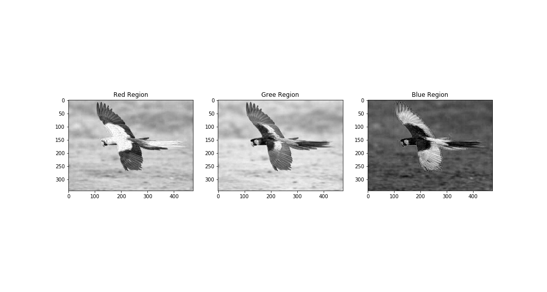
(343, 473)
(343, 473)
(343, 473)
(343, 473 , 3)
(343, 473)
(343, 473)
(343, 473)

Slide 8
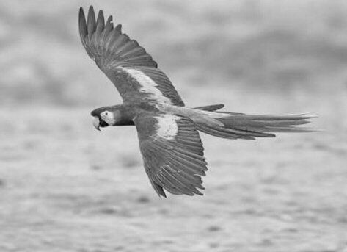
Use of Grayscale image
(343, 473 , 3)
(343, 473)
Length of matrix or array reduce by 3 times hence the computation time

Slide 9



Deeper into Image
PIXELS
(1200 , 1200 , 3)

Slide 10
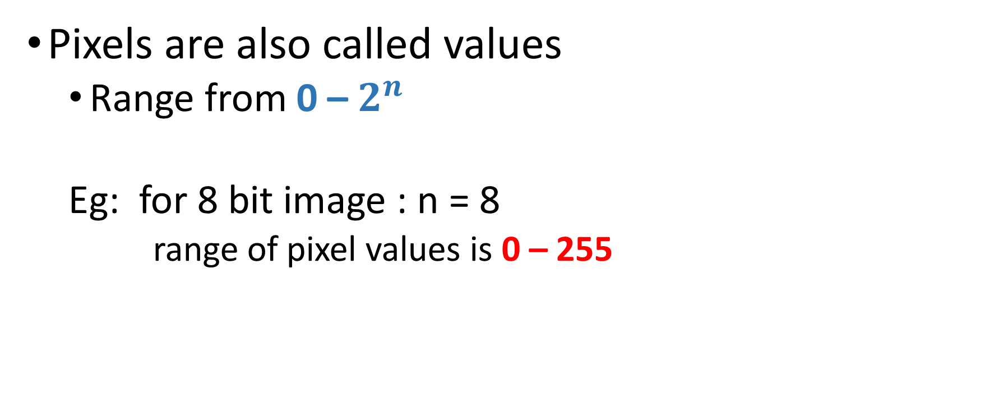
PIXELS
Pixels are also called values
Range from 0 – $2^{n}$
Eg: for 8 bit image : n = 8
range of pixel values is 0 – 255

Slide 11
PIXELS
Lower the value darker the color
Eg: black color for gray scale image
Higher the value lighter the color
Eg: White color for gray scale image
0
255

Slide 12
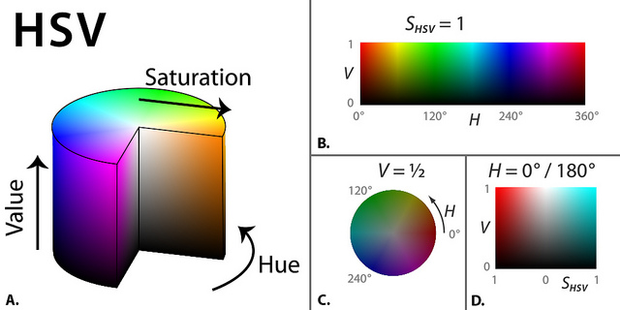
Color Space

Slide 13

Array in graphical representation
Image is matrix and representation in graphical manner
0
230
255
53
235
255
20
240
255
0
255
70
255
100
120

Slide 14
Information in Image
Skill of extraction information or knowledge from data is called Data Science
Transformation
Analysis
Modeling
(1200, 1200)

Slide 15
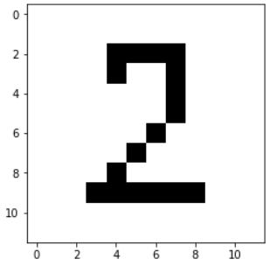
Data Transformation
Transforming the data into structured
Resize {Bring the all image into same shape}
Reshaping
Converting into either row matrix or column matrix
(10, 10)
(1, 100)

Slide 16
Analysis
Number of black bars
Distance between each bars
Width of each bars
Position or index of bars
(1, 100)

Slide 17
Train images or arrays

Slide 18
Face ?
Converting into Grayscale
Resize (Bring face into same size)
Reshaping
Transforming
Building Model

Slide 19

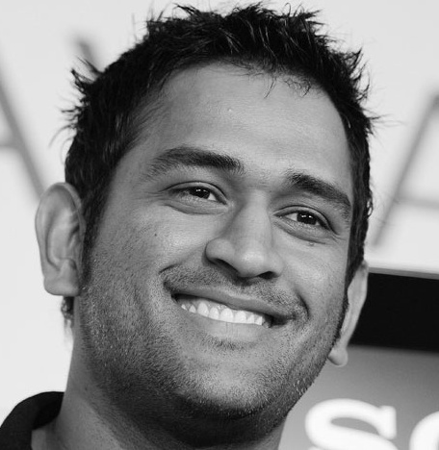
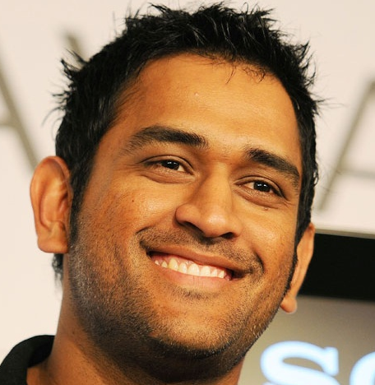

Slide 20

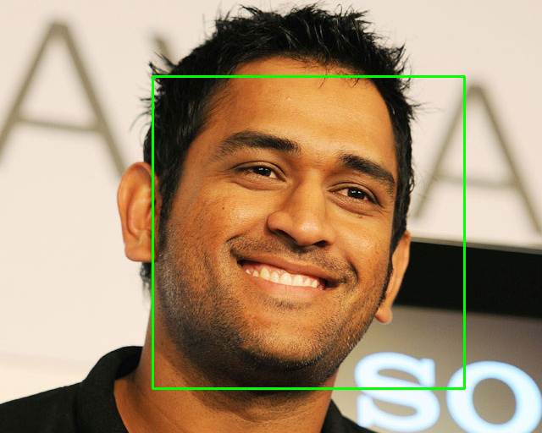

Recognition Algorithm
Input Image
Detect Face
Identify Shape or Transforming
Classification
128D unit Hyper sphere
Similarity Detection
Clustering
Deep Neural Network

Slide 21
Building Face Recognition Model

